Slide 1
Capstone 2 Final Report:
Yelp Dataset Image Classification
Nils Madsen
10/25/18

Slide 2
Goal and Utility
Users uploading images to Yelp do not always fill in all the information about the image
There are motivations to fill missing information in Yelp’s database:
Enables data analyses with more observations and fields
Could allow sorting and filtering of images by type, for end-user or internal benefit
It would not be financially feasible to hire people to categorize images
Fortunately, modern machine learning algorithms, especially convolutional neural networks (CNN), are fast and accurate for image classification tasks
The goal of this project was to classify images from Yelp’s database into broad categories using a CNN architecture

Slide 3
Convolutional Neural Networks
CNNs are a modern variation of traditional neural networks, and gained popularity after AlexNet won the 2012 ImageNet Challenge in dramatic fashion (15% error vs 25% error of runner-up)
CNNs expand on neural networks by incorporating automated feature extraction (convolutional layers) before fully-connected neural network layers
Convolutional layers function by learning patterns that recur in small 2D windows (typically 3x3 or 5x5 pixels) throughout the image
By keeping 2-dimensional structure of the image intact (vs flattening for dense neural networks), CNNs are able to detect more meaningful patterns
Using multiple layers and pooling, CNNs can also identify larger and more abstract 2D patterns in images

Slide 4
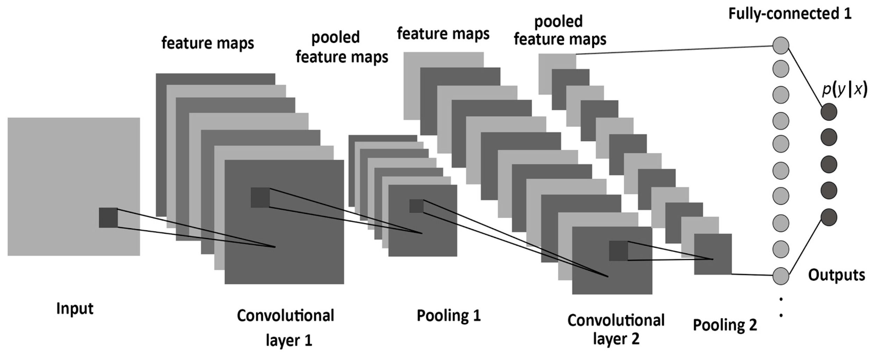
Convolutional Neural Networks
Albelwi, Mamood. (2017) ‘A Framework for Designing the Architectures of Deep Convolutional Neural Networks’. Entropy 2017, 19(6), 242.

Slide 5
Data
Yelp has published a dataset for academic use:
https://www.yelp.com/dataset/challenge
Multiple fields for each business:
Location, name, type, star rating, full-text reviews, etc.
Multiple fields for each user:
Join date, number of reviews written, number of compliments received, etc.
Multiple fields for each image:
Label, caption, associated business

Slide 6
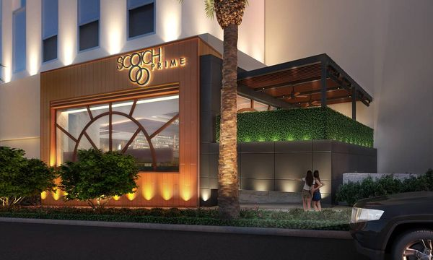
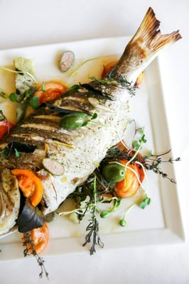
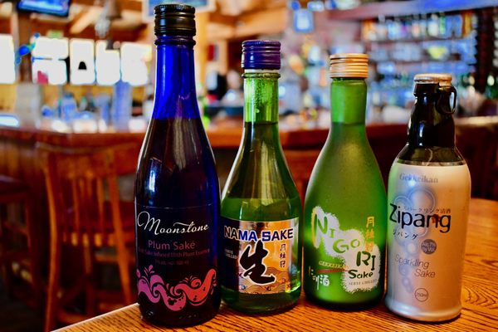
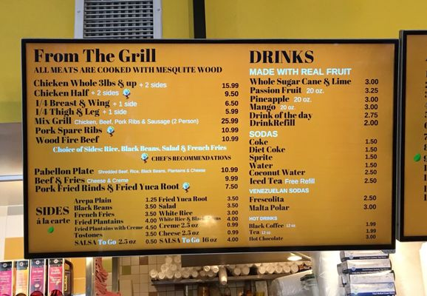
Data (cont.)
This project focused on predicting the ‘label’ for each image, which is composed of five classes:
Food, drink, menu, inside, outside
Full-color RGB images, typically cellphone-quality or better
There are a total of 280,992 images in the Yelp Dataset

Slide 7
Data Cleaning and Handling
Data Cleaning and Image Inspection:
There are no missing values in the ‘label’ field, and all labels are in the set of 5 classes
There are a relatively small number of duplicated images. These images are almost all stock/ promo images, and were not removed because they will likely show up again in the future
There is some degree of ambiguity (i.e. more than one class present in the image) and misclassification in the image set, which will limit the maximum possible performance of the CNN
File Handling:
Image label data was converted from json to csv format using pandas
Image files were sorted into directories using python’s build-in OS utilities

Slide 8
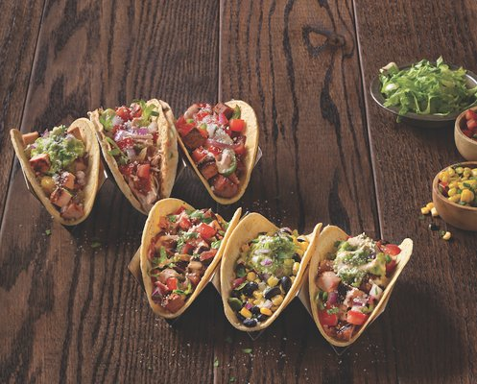
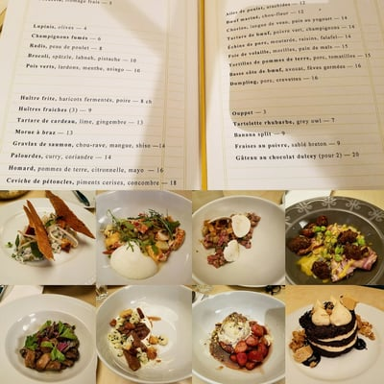
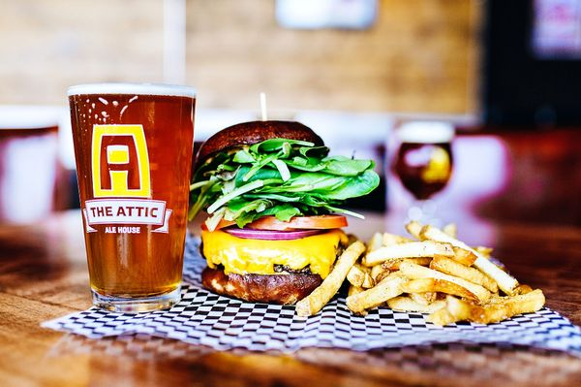
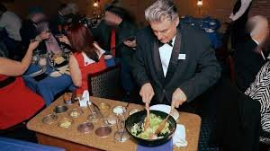
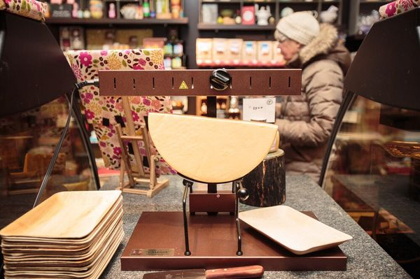
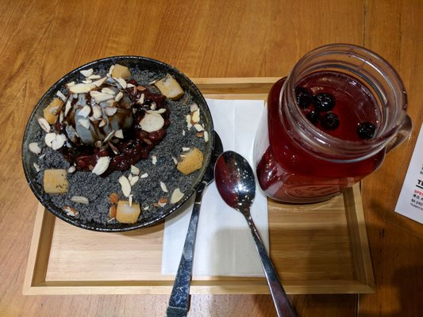
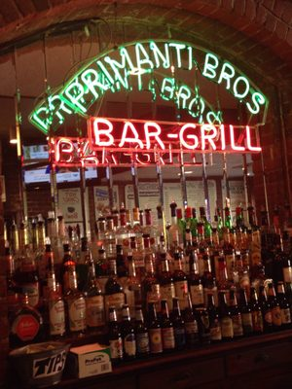
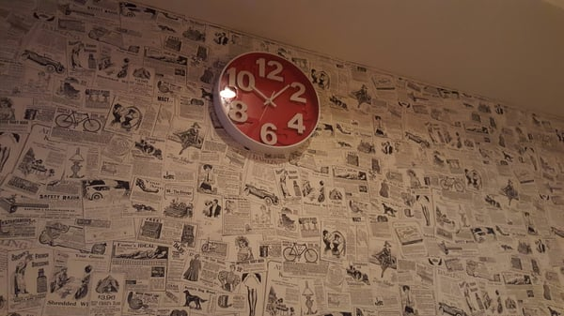
Ambiguity and Misclassification Examples
“Inside”
“Menu”
“Drink”
“Food”
“Outside”

Slide 9
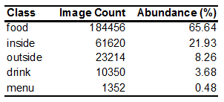
Other Challenges
There is a dramatic degree of class imbalance in the dataset, which will prevent the model performing well on the minor classes if not addressed adequately:
CNN architectures are time consuming to design, and ultimate performance is heavily dependant on weight initialization and training set size
CNNs require a large amount of computing time and power to train, and I have limited hardware (nVidia 1060 6GB GPU)
Long training times become especially problematic during hyperparameter tuning (days of training for each hyperparameter if using full image set)

Slide 10
Image Processing Pipeline
Assign images to training/validation/test sets by randomly sampling Yelp json data in Pandas
Sort images into different directories based on image set and label using Python’s system utilities
Construct Keras ImageDataGenerator and instruct it to perform real-time image augmentation for the training set (ImageDataGenerator performs batch-wise image normalization by default)
Use ImageDataGenerator’s .flow_from_directory method to produce a generator for each image set (i.e. train/val/test)
Fit Keras CNN model to the data by calling .fit_generator method and passing training and validation generators
Evaluate accuracy and loss of model on val/test sets using .evaluate_generator method
Produce predicted probabilities of val/test sets using .predict_generator method
Produce confusion matrix, macro-recall, macro-F1, and macro-AUC from predicted probabilities using scikit-learn functions (confusion_matrix, f1_score, roc_auc_score)

Slide 11
Image sets
Images were randomly divided into training, validation, and test sets:
Training: 230,992 images
Validation: 20,000 images
Test: 30,000 images
These sets reflect the class imbalance of the full image set:
Abundance of each class in each image set (%)

Slide 12
Approach to Model Design
Transfer learning approach: fine-tuning a pre-built, pre-trained model on new data
This approach avoids the time-consuming and difficult architecture design and weight initialization steps for CNNs while still producing good performance
The VGG-16 CNN placed second in the 2014 ImageNet challenge and is available as a pre-loaded template in Keras
Downsampling (also known as ‘undersampling’) was used to create a smaller, class-balanced image set to use for tuning hyperparameters of the CNN
Evaluation metrics:
Accuracy and loss are not good metrics for the full image set due to class imbalance, but will be fine for tuning on the downsampled image set
Macro-averaged recall was included as a class-imbalance-insensitive measure of performance
Macro-averaged F1 score and ROC-AUC were included to incorporate precision performance into evaluation

Slide 13
Preliminary Model Architecture
VGG-16 convolutional layers
Two newly-initialized, fully-connected layers at the end, with ReLU activations
A dropout layer after each of the fully-connected layers
An output layer composed of 5 nodes, with softmax activation and categorical cross-entropy as the loss function
Adam optimizer for gradient descent

Slide 14
Preliminary Model Layers

Slide 15
Approach to Hyperparameter Tuning
Since neural network performance can depend heavily on the random initialization state of weights, each tuning condition was trained in triplicate
Any replicate which did not converge to greater than 70% accuracy was discarded
The metrics of the converging models were averaged within each condition
More computing power would allow for more replicates, and therefore a more reliable picture of the best tuning conditions
Macro recall was not reported for hyperparameter tuning on the downsampled image set due to its being equivalent to accuracy in the case of perfect class balance

Slide 16
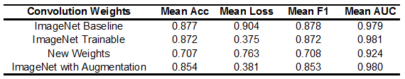
Tuning: Convolutional Weights and Augmentation
Using VGG-16’s pretrained ImageNet weights performed better than newly- initialized weights
Allowing the ImageNet weights to be tuned further performed the best
Adding image augmentation, including horizontal flipping, horizontal and vertical shifting, and varying zoom, performed similarly to trainable ImageNet weights

Slide 17
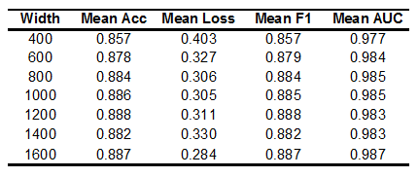
Tuning: Model Capacity
The number of nodes in the fully connected layers will influence the model’s tendency to overfit vs generalize
The model’s validation performance improved up to a node count of 800-1000 before leveling off
1000 nodes per layer was selected as a safe minimum-size-required for the model

Slide 18
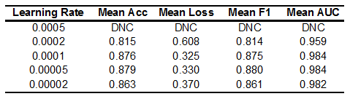
Tuning: Learning Rate
A learning rate for the Adam optimizer that is too high or too low can lead to the model converging to a worse solution, or not converging at all
A learning rate of 0.0001 was found to be optimal, with 0.00005 and 0.0002 performing slightly worse and 0.00002 producing a much worse solution
A learning rate of 0.0005 did not converge to a solution.

Slide 19
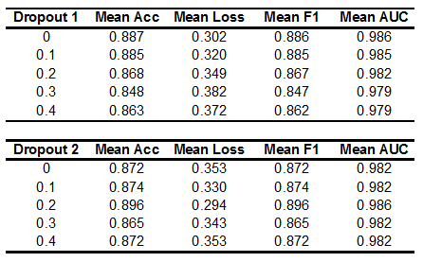
Dropout
Dropout is a powerful technique for preventing model overfitting and improving validation performance
A random proportion of nodes in each layer are selected to be dropped for each training batch
Dropout forces the model to store a more robust, redundant representation of the patterns in the image set
Layer size was increased relative to dropout proportion
For the first fully-connected layer, having no dropout performed best
For the second fully-connected layer, a dropout of 0.2 performed best

Slide 20
Final Model Design
VGG-16 convolutional layers with pretrained weights from the ImageNet competition, with the capability of further tuning these weights for this dataset
Two fully connected layers with ReLU activations. First layer is composed of 1000 nodes, while the second is composed of 1250 nodes (to account for dropout)
No dropout regularization in the first FC layer, and a dropout of 0.2 in the second FC layer
An output layer composed of 5 nodes, with softmax activation and categorical cross-entropy as the loss function
Image augmentation in the form of horizontal flip, horizontal and vertical shift, and zoom, with fill by reflection
A learning rate of 0.0001 for the Adam optimizer

Slide 21
The Problem of Class Imbalance
The model trained on the downsampled image set achieved an accuracy of 88.9%, macro recall of 89.2%, and macro F1 of 0.747 when predicting the full validation set
In contrast, a model trained on the full, unbalanced image set achieved an accuracy of 93.1%, macro recall of 67.8%, and macro F1 of 0.721
The poor macro recall of the latter model is the result of an abysmal 21% recall on the menu class, and a very poor 47% recall on the drink class
Poor performance on the minor classes cannot be tolerated, as the model must be able to accurately classify all classes no matter how often each is uploaded
The class imbalance must be addressed in some way

Slide 22
Approaches to solving class imbalance
Balanced class weights: Increase the relative impact of the minor classes on the loss function
Combined model: Combine the outputs of the downsampled model and the model trained on the full, unbalanced image set into one 10-node layer. Then, train a new 5-node layer on these outputs using the downsampled image set
Hybrid training: Train the model in two phases. During the first phase, train the model on the downsampled image set to establish good performance on all classes. Then in the second phase, train the model on the full image set to improve performance on the major classes
Balanced class weights: use balanced class weights in the second phase
Root class weights: use the square-root of the balanced class weights in the second phase

Slide 23
Approaches to solving class imbalance: Results
Two-phase training using the square-root of the balanced class weights in the second phase (Hybrid-root) produced the best performance by far
Using balanced class weights only (Full-balanced) produced worse performance than downsampling (Downsampled)
Two-phase training using the balanced class weights in the second phase (Hybrid-balanced) produced similar results to combining the outputs of the Downsampled and Full-unbalanced model and training a new 5-node output (Combined)

Slide 24
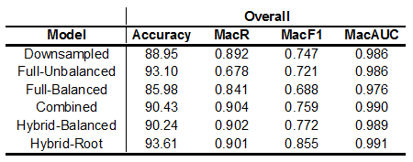
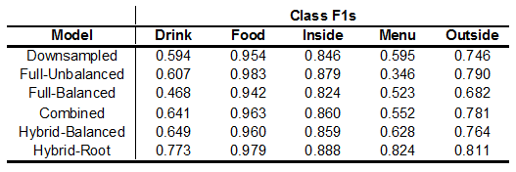
Approaches to solving class imbalance: Results

Slide 25
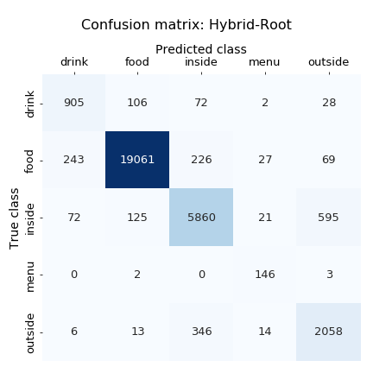


Model performance on test set
Evaluating the performance of the hybrid-root model on the test set of 30,000 images yielded an accuracy of 93.4%, macro-recall of 89.5%, and macro-F1 of 0.849
This is similar to the validation set performance, and indicates that the model has learned a generalizable conception of the classes

Slide 26
Possible Future Directions
With more time and computing power available, a CNN architecture could be built from scratch that is tailored for this task:
ImageNet problem is more complex, so smaller architecture might be better for this task
Easy implementation of more advanced techniques such as batch normalization and replacing pooling layers with learnable stride-2 layers
Other approaches to class imbalance:
Feed different randomly-downsampled image set for each training epoch
Upsampling (also known as ‘oversampling’), where images in the minor classes are duplicated up to the count of the major class
Split the task into 5 binary one-vs-other classifiers, with each classifier learning from a downsampled image set where its class comprises 50% of the images

Slide 27
Tools Used
Hardware:
CPU: Intel i7-3770k
Memory: 16GB DDR3 at 1600 MHz
GPU: Nvidia GTX 1060 6GB
Software:
Python 3.6.4 Anaconda 4.5.4 Numpy 1.15.1 Pandas 0.23.4 Scikit-learn 0.19.1 Tensorflow-gpu 1.10.0 Keras 2.2.2 CUDA 9.0.176
Windows 7

Slide 28
References
Yelp Dataset: https://www.yelp.com/dataset/challenge Keras VGG16 implementation: https://keras.io/applications/#vgg16 VGG16 Architecture: Simonyan and Zisserman. (2015) ‘Very Deep Convolutional Networks for Large-Scale Image Recognition.’ arXiv:1409.1556. 10 Apr 2015. Addressing Class Imbalance in CNNs: Buda et al. (2017) ‘A systematic study of the class imbalance problem in convolutional neural networks.’ arXiv:1710.05381v1. 15 Oct 2017. Hybrid training (a.k.a. two-phase training): Havaei et al. (2016) ‘Brain Tumor Segmentation with Deep Neural Networks.’ arXiv:1505.03540v3. 20 May 2016.

